Slide 1
Chemical Equilibrium with Applications for MATLAB Quick Start Guide
Sam Kobliska, ERC Inc.
Chip Kopicz, ERC Inc.
2/7/2017

Slide 2
CEA for MATLAB
Discuss basic MATLAB syntax for use in CEAM
Provide input format for using CEAM
Show data extraction from CEAM
Structure format
Screen
File
Questions and practical application

Slide 3
Content
Contents
CEA for MATLAB file CEA.p
CEA for MATLAB help file CEA.m
CEA for MATLAB thermodynamic library thermo_lib.mat
This CEAM slide package.

Slide 4
How does CEA for MATLAB Work?
CEAM balances mass and energy to solve the combustion process.
Mass (Continuity)
Mass is balanced at the atomic level. The sum of the products of the molar values and their respective number of nuclei must remain constant.
Moles are not necessarily conserved
Molecules are not necessarily conserved
Energy
Energy is conserved by either using the user defined thermodynamic state or the thermodynamic database defined state, i.e. default values.
Assumptions
The flow, if applicable, is axis-symmetric and 1-D
Perfect Nozzle
Instantaneous chemical reaction rate

Slide 5
Basic MATLAB Syntax
Strings
Strings must be encased in single quotation marks such as ‘string’
Strings will show on the screen in magenta, such as ‘equilibrium’
MATLAB is by its nature case sensitive. CEAM was written to remove as much case sensitivity as possible
Comments
The comment symbol in MATLAB is a percentage sign (%)
Comments can be on the same line as a command, but anything after the percentage sign is a comment.
Comments appear on the screen in green
For example: X=5; %X is the number of inputs
Line Termination
The command line should to be terminated with a semicolon (;)
If a semicolon is not used, the line will print to the screen
Line Continuation
Command lines can be continued onto the next line with using an ellipsis (…)

Slide 6
Basic MATLAB Syntax - Continued
Numbers
Numeric values can be entered three ways.
A number: 5
As defined variable name: X when X has been defined in a previous line of code.
An array: 1:0.2:5 which is in the format of initial_value:increment:end_value
The end value can be the final value in the array, but that is not always true
The final value is the last incremental value that satisfies the requirement that the array values be equal to or within the bounds of the end value
For example: 1:4:10 has a end value of 10, but a final value of 9. (1,5,9)
For example: 10:-4:1 has a end value of 1, but a final value of 2. (10,6,2)
If the end value is greater than the initial value, the increment must be positive.
Similarly, is the end value is less than the initial value, the increment must be negative
If the array only consists of 2 inputs, then MATLAB assumes an increment of 1. For example: 12:30 is the same as 12:1:30
Variable names can be used in arrays as well.
For a example: x=1; y=0.2; z=5; x:y:z is acceptable
The results can be combined for chamber conditions, for example:
X=2500;
…’p,psia’,1000:100:2000,X,3000,…
The numeric inputs do not have to be in any particular order

Slide 7
Input Deck Format
The CEAM input was designed to be as close to the legacy FORTRAN input as possible.
Example of a legacy FORTRAN input deck
problem hp
equilibrium
o/f=2.34
case=fastrak(O2/RP-1)
p(psi)=633.
reactants
fuel = RP-1(L) C=1. H=1.9423, wt% 100. h,cal/mol -5430. t(k) 300.0
oxid = O2(L) O=2., wt% 100. h,cal/mol -3032. t(k) 94.44
output calories transport
end
Step 1 in CEAM Conversion
Add output assignment, and function call. The added text is in red to show contrast.
Output=CEA(problem hp
equilibrium
o/f=2.34
case=fastrak(O2/RP-1)
p(psi)=633.
reactants...

Slide 8
Input Deck Format
Step 2
Add commas to separate variables and bring inputs to a line format from a paragraph format. Remove equal signs and replace with commas
Output=CEA(problem,hp,equilibrium,o/f,2.34,case,fastrak(O2/RP-1),p(psi),633.,
reactants,fuel,RP-1(L),C,1.,H,1.9423,wt%,100.,h,cal/mol,-5430.,t(k),300.0,
oxid,O2(L),O,2,wt%,100.,h,cal/mol,-3032.,t(k),94.44,output,calories, transport,end
Step 3
Encase words in single quotes
Output=CEA(‘problem’,’hp’,’equilibrium’,’o/f’,2.34,’case’,’fastrak(O2/RP-1)’, ’p(psi)’,633.,‘reactants’,’fuel’,’RP-1(L)’,’C’,1.,’H’,1.9423,’wt%’,100., ’h,cal/mol’,-5430.,’t(k)’,300.0,‘oxid’,’O2(L)’,’O’,2,’wt%’,100., ’h,cal/mol’,-3032.,’t(k)’,94.44,’output’,’calories’,‘transport’,’end’
Step 4
Close the input with a closed parenthesis and a semicolon. The added text is in red to show contrast.
Output=CEA(‘problem’,’hp’,’equilibrium’,’o/f’,2.34,’case’,’fastrak(O2/RP-1)’, ’p(psi)’,633.,‘reactants’,’fuel’,’RP-1(L)’,’C’,1.,’H’,1.9423,’wt%’,100., ’h,cal/mol’,-5430.,’t(k)’,300.0,‘oxid’,’O2(L)’,’O’,2,’wt%’,100., ’h,cal/mol’,-3032.,’t(k)’,94.44,’output’,’calories’,‘transport’,’end’);
Step 5
Execute the code

Slide 9
CEAM General Inputs
CEAM is called in MATLAB with the following syntax:
Output_Variable=CEA(User_Defined_inputs);
Where Output_Variable is the user defined variable that will store the structure that CEAM outputs
“CEA“ is case sensitive
User_Defined_inputs is the compilation of all applicable datasets
Mandatory
Reactants
Problem
End
Optional
Output
Insert
Only
Omit
Datasets can be entered in any order except for “end” which must be the last dataset
Data entries are comma separated

Slide 10
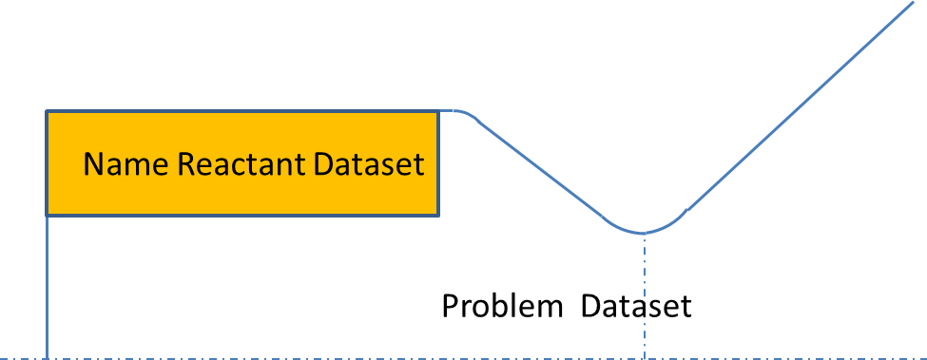
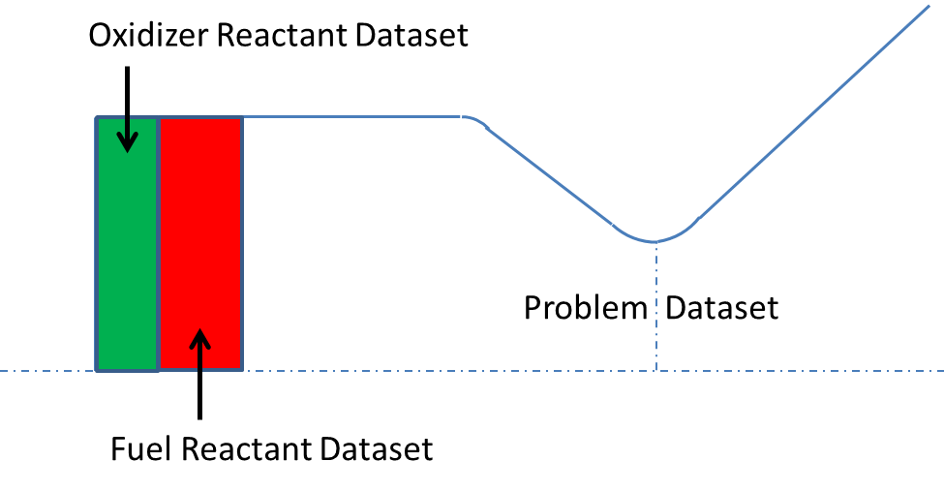
Reactant and Problem Datasets
What are the reactant and problem datasets and what do they each contain?
Reactant Dataset
The reactant dataset contains properties that are specific to the respective reactant
It may be helpful to think of the reactant dataset as “manifold”, “upstream”, or “grain” conditions.
Problem Dataset
The problem dataset contains properties that are bulk combustion properties and are not specific to any reactant
The problem dataset includes chamber and nozzle declarations, if applicable
It may be helpful to think of the problem dataset as “chamber” conditions

Slide 11
Mandatory Datasets
Reactant
The reactant dataset contains:
Type of each reactant
Name of each reactant
Chemical formula of each reactant
Type of amount of each reactant (mass or mole)
Amount of each reactant with respect to type of reactant
Specific information such as enthalpy, temperature, or density for each reactant (if applicable) for each reactant
In the event of duplicate input between the problem dataset and the reactant dataset, the reactant dataset input will be used and the problem dataset input will be dismissed.
Problem
Problem contains the type of problem, and the bulk property inputs. The bulk property inputs vary on the type of problem and will be addressed on a later slide.
End
End marks the end of an input

Slide 12
Reactant Dataset
The reactant dataset contains all inputs to an assigned case that are specific to a reactant
NOTE: The “library” option is slow and limits the reactant input and is not recommended.
Keyword
The keyword for the reactant dataset is ‘reac’. Any word in the CEAM input that starts with the keyword will be recognized as the start of the reactant dataset.
Mandatory Input
Reactant type
Every reactant must start with a reactant type.
The type declaration start as new reactant and ends any previous reactant definition.
Each reactant must be completely defined before the next reactant is declared
The keyword is a string input
There are three reactant types and two acceptable input formats.

Slide 13
Reactant Dataset - Continued
Mandatory Input – Continued
Reactant type
Name
The keyword for name is ‘na’. Name is used if some reactants may contain both fuel and oxidizer components. Name is not common in liquid propulsion systems, but is common in solid propulsion systems. If name is used for one reactant, it must be used for all reactants.
A bulk mixture ratio is undefined when using the “name” nomenclature since fuel and oxidizer is not defined.
Fuel and Oxidizer Input Format
The keyword for fuel is ‘fu’, and the keyword for oxidizer is ‘ox’

Slide 14
Reactant Dataset - Continued
Mandatory Input – Continued
Reactant name
The reactant name is a variable name or string input and is not case sensitive
The reactant name must immediately follow the propellant type declaration
If the library option is used, the reactant name must match the name in the library
Chemical formula
The chemical formula is mandatory unless the library option is used.
The chemical formula is not case sensitive.
The chemical formula alternates between a string input of the atomic symbol and the number of atoms corresponding to the respective symbol
The order in which the chemical formula is entered is irrelevant. ‘H’,2,’O’,1 and ‘O’,1,’H’,2 are recognized as the same formula.
Type and amount of each reactant
There are two types of reactant amounts recognized by CEAM. The types cannot be mixed.
Moles
The keyword is ‘m’.
The molar amount of the propellant must immediately follow the keyword.
Using molar amounts completely defines the mass balance of the reactants and a mixture ratio input in the problem dataset is unnecessary

Slide 15
Reactant Dataset - Continued
Mandatory Input – Continued
Type and amount of each reactant
Mass or Weight Fraction and Name Propellant Type
The keyword is ‘w’.
The amounts are specific to the propellant type and also the complete mixture.
The amounts are normalized to the mixture. The amounts do not have to add up to any particular number. For example, if reactant A has a weight fraction of 87, and reactant B has a weight fraction of 50, then the weight fraction of reactant A is 87/(87+50). Similarly, reactant B has a fraction of 50/(87+50).
The amount value must follow the amount type. Only a single value is allowed.
A bulk mixture ratio cannot be defined in the problem dataset when using this option.

Slide 16
Reactant Dataset - Continued
Mandatory Input – Continued
Type and amount of each reactant
Mass or Weight Fraction and Fuel and Oxidizer Propellant Type
The keyword is ‘w’.
The amounts are specific to the propellant type.
The amounts are normalized to the propellant type. The amounts do not have to add up to any particular number. For example, if fuel A has a weight fraction of 87, and fuel B has a weight fraction of 50, then the weight fraction of fuel A is 87/(87+50). Similarly, fuel B has a fraction of 50/(87+50).
The amount value must follow the amount type. Only a single value is allowed.
Note that the above fraction defines only the fuel and not the oxidizer.
A bulk mixture ratio must be defined in the problem dataset when using this option.

Slide 17
Reactant Dataset - Continued
Optional Input
Note that that title of “optional input” may not be accurate. A given problem will require additional input that may be entered in either the reactant dataset as a reactant specific property or possibly in the problem dataset as a bulk property. In the event that a property is defined in both the reactant and problem datasets, CEAM will dismiss the problem dataset inputs(s), and include the reactant dataset input(s).
Units are entered after the keyword. The two must be separated by a delimiter such as colon, semicolon, space, comma
Temperature
Temperature is required for HP, UV, and Rocket problems
The input temperature should correspond to a upstream or “manifold” temperature
The keyword for temperature is not case sensitive and is exactly ‘t’
The allowable temperature are as follows:
The temperature value must follow the amount type. Only a single value is allowed.
Temperature | Keyword
Rankine | R, r
Fahrenheit | F, f
Kelvin | K, k
Celsius | C, c

Slide 18
Reactant Dataset - Continued
Optional Input - Continued
Enthalpy
Enthalpy is required for HP, and Rocket problems
Enthalpy in the reactant dataset corresponds to reactant enthalpy
The keyword for enthalpy is not case sensitive and is ‘h’
The units are flexible. Enthalpy is in units of energy per mass. The allowable units energy and mass are not case sensitive and are as follows:
The units of energy and mass must be separated by a division sign (/)
The value of enthalpy must immediately follow the enthalpy keyword.
Only a single value is allowed per reactant.
The value of enthalpy must be the total enthalpy
For example: …’h,calories/mole’,-2152,… is an acceptable input
Energy | Keyword(s)
BTU | Btu
calorie | Cal, c
kilocalorie | Kc, kiloc
Joule | J
kilojoule | Kj,kiloj
Mass | Keyword(s)
Gram | g
Kilogram | Kilog, kg
Pound Mass | Lbm
Mole | mol

Slide 19
Reactant Dataset - Continued
Optional Input – Continued
Energy
Energy is required for UV problems
The keyword for enthalpy is not case sensitive and is exactly ‘u’
The units are the same as the units for enthalpy.
The value of energy must immediately follow the energy keyword. Only a single value is allowed per reactant
Density
Density is completely optional
The keyword for density is not case sensitive and is exactly ‘rho’
The units are flexible. Density is in units of mass per volume. The allowable units mass and volume are not case sensitive and are as follows:
The units of mass and volume must be separated by a division sign (/)
The value of density must immediately follow the density keyword. Only a single value is allowed per reactant.
Mass | Keyword(s)
Gram | g
Kilogram | Kg
Pound Mass | Lbm
Volume | Keyword(s)
Cubic centimeter | cc
Cubic meter | m^3
Cubic foot | ft^3

Slide 20
Reactant Dataset - Continued
Examples
'reactants','fuel','H2(L)','H',2,'wt%',100,'h,BTU/lbm',-1920.7,'t,r’,30.31,...
'oxid','O2(L)','O',2,'wt%',100,'h,Btu/Lbm',-174.263,'t,r',162.324,
'reac','oxid','Air','N',1.5617,'O',0.41959,'AR',0.00937,'C',0.00032,...
'wtfrac',1,'h,J/mol',12077.218,'t,k',700,'fuel','C7H8(L)','C',7,'H',8,...
'h,J/mol',12180,'wtfrac',0.4,'t,k',298.15,'fuel','C8H18(L)','C',8,'H',18,...
'h,J/mol',-250260,'wtfrac',0.6,'t,k',298.15,
'reactants','fuel','H2(G)','H',2,'wt%',100,'h,cal/mol','t:k',298,...
'oxid','O2(G)','O',2,'wt%',100,'h,cal/mol','t:k',298,
'reac','fuel','H2','H',2,'moles',1,'oxid','Air','N',1.5617,'O',0.41959,'AR',0.00937,'C',0.00032,'moles',1,
'reactants','name','HEHN','wt',44.500,'C',2,'H',9,'N',3,'O',4,'h,...
kcal/mol',-98.000,'rho,g/cc',1.428,'name','HAN','wt',41.830,'H',4,'N',2,...
'O',4,'h,kcal/mol',-95.300,'rho,g/cc',1.090,'name','AN','wt',02.225,'H',4,... 'N',2,'O',3,'h,kcal/mol',-87.380,'rho,g/cc',1.725, 'name','DIPY','wt',...
0.445,'C',10,'H',8,'N',2,'h,kcal/mol',44.478,'rho,g/cc',1.326,'name',...
'Water', 'wt',11.000,'H',2,'O',1,'h,kcal/mol',-68.313,'rho,g/cc',1.000,

Slide 21
Problem Dataset
The problem dataset contains all the case type and all inputs to assigned case that are not specific to a reactant
‘prob’,’type’,’mixture type’,mixture value(s),’state variable 1’,state variable 1 value(s) ,’state variable 2’,state variable 2 value(s)…)
Mandatory
Problem type
State variables
Mixture Ratio (if not moles in reactant dataset)
Optional
Case title
Rocket
Area ratio / Pressure ratio
Equilibrium / Frozen
Finite area chamber

Slide 22
Problem Dataset
Mandatory Inputs
Keyword
The keyword is ‘prob'. The keyword is not case sensitive, and must be the first word in the dataset.
Problem Type
The problem type identifies the state variables that will be used to solve the combustion problem
The problem type can be entered anywhere in the problem dataset
State variable problem types are reversible. For example: ‘HP’, and ‘PH’ represent the same problem type
The keywords for shock, detonation, and rocket are order sensitive. For example: ‘DET’ is recognized, but ‘TED’ is not recognized
The problem type is not case sensitive
Assigned Variables | Keywords
Temperature and Pressure | TP, PT
Enthalpy and Pressure | HP, PH
Entropy and Pressure | SP, PS
Temperature and Volume(Density) | TV, VT
Energy and Volume(Density) | UV, VU
Entropy and Volume(Density) | SV, VS
Rocket | RKT, or RO
Shock | SH
Chapman-Jouget Detonation | DET

Slide 23
Problem Dataset
Mandatory Inputs-Continued
Problem Type Inputs
Pressure
Pressure is a required input for HP, TP, SP, Rocket, Shock, and Detonation problems
Pressure will always be entered in the problem dataset
The keyword for pressure is exactly ‘p‘ and it is not case sensitive
The units are declared following the keyword and a delimiter
The allowable units are not case sensitive and are as follows:
The value(s) of pressure can be input as arrays, variables, and numerical values
Pressure | Keyword
Bar | bar
Atmosphere | atm
Pounds per square inch absolute | psi
Millimeters of mercury | mmh

Slide 24
Problem Dataset
Mandatory Inputs-Continued
Problem Type Inputs
Temperature
Temperature is a required input for TP, TV, and Detonation problems
Temperature is optional for Rocket problems (can be helpful for low mixture ratio combustors)
Temperature will always be entered in the problem dataset
The keyword for temperature is exactly ‘t‘ and it is not case sensitive
The units are declared following the keyword and a comma
The allowable units are not case sensitive and are as follows:
The value(s) of temperature can be input as arrays, variables, and numerical values
Temperature | Keyword
Kelvin | K
Celsius | C
Rankine | R
Fahrenheit | F

Slide 25
Problem Dataset
Mandatory Inputs-Continued
Problem Type Inputs
Enthalpy
Enthalpy is a required input for HP, and Rocket problems
Enthalpy can be entered in either the problem dataset, or the reactant dataset. If enthalpy is entered both the problem dataset and the reactant dataset, the reactant dataset enthalpy will be used, and the problem dataset enthalpy input will be dismissed. If enthalpy is entered into the problem dataset, it must be the enthalpy of the product mixture.
The keyword for enthalpy is exactly ‘h‘ and it is not case sensitive
The units are flexible. Enthalpy is in units of energy per mass. The allowable units energy and mass are not case sensitive and are as follows:
The units of enthalpy and mass must be separated by a division sign (/)
The value of enthalpy must immediately follow the enthalpy keyword.
The value of enthalpy must be the total enthalpy
For example: …’h,calories/mole’,-2152,… is an acceptable input
An alternative is units of h/R (kg-mole-K/kg-mixture)
Energy | Keyword(s)
BTU | Btu
calorie | Cal, c
kilocalorie | Kc, kiloc
Joule | J
kilojoule | Kj,kiloj
Mass | Keyword(s)
Gram | g
Kilogram | Kilog, kg
Pound Mass | Lbm

Slide 26
Problem Dataset
Mandatory Inputs-Continued
Problem Type Inputs
Energy
Energy is a required input for UV problems
Energy can be entered in either the problem dataset, or the reactant dataset. If energy is entered both the problem dataset and the reactant dataset, the reactant dataset energy will be used, and the problem dataset energy input will be dismissed. If energy is entered into the problem dataset, it must be the energy of the product mixture.
The keyword for energy is exactly ‘u‘ and it is not case sensitive
The units of energy are identical to the units of enthalpy

Slide 27
Problem Dataset
Mandatory Inputs-Continued
Problem Type Inputs
Entropy
Entropy is a required input for SP problems
Entropy must be entered in the problem dataset
The keyword for entropy is exactly ‘s‘ and it is not case sensitive
The units of entropy are in energy per mass-temperature. The units of entropy are similar to the units of enthalpy and energy. A temperature is added to the denominator.
The units of energy and mass must be separated by a division sign (/)
The value of entropy must immediately follow the entropy keyword.
For example: …’s,J/kg-K’,… is an acceptable input
An alternative is units of s/R (kg-mole/kg-mixture)
Energy | Keyword(s)
BTU | Btu
calorie | Cal, c
kilocalorie | Kc, kiloc
Joule | J
kilojoule | Kj,kiloj
Mass | Keyword(s)
Gram | g
Kilogram | Kilog, kg
Pound Mass | Lbm
Temperature | Keyword
Kelvin | K
Celsius | C
Rankine | R
Fahrenheit | F

Slide 28
Problem Dataset
Mandatory Inputs-Continued
Problem Type Inputs
Specific Volume – Density
Specific Volume or density are required for TV, UV, and SV problems
Specific Volume or density must be entered in the problem dataset
The keyword for specific volume is exactly ‘v‘ and it is not case sensitive
The keyword for density is exactly ‘rho‘ and it is not case sensitive
The units of specific volume are volume per mass
The units of density are mass per volume
The numerator and denominator must be separated by a division sign (/)
The value(s) must immediately follow the keyword.
Volume | Keyword(s)
Cubic centimeter | cc
Cubic meter | m^3
Cubic foot | ft^3
Mass | Keyword(s)
Gram | g
Kilogram | Kilog, kg
Pound Mass | Lbm

Slide 29
Problem Dataset
Mandatory Inputs-Continued
Mixture Ratios
Mixture ratio is required if the reactant amount defined in the reactant dataset are not in moles
There are several keywords for the mixture ratio depending the definition of the mixture ratio. The mixture ratio types are as follows:
More than one mixture ratio can be defined, but only one type of mixture ratio can be used for a single problem.
The value(s) of mixture ratio can be input as arrays, variables, and numerical values
Optional – Case Name
The case name is a file name printed in the output. The name is a string that follows the keyword ‘case‘.
For example: ‘case’,’Example for class’,
Mixture Ratio Type | Keyword
Percent fuel by mass | %f
Fuel-to-oxidant weight ratio | f/o, f/a
Oxidant-to-fuel weight ratio | o/f
Equivalence Ratio (Equation 9.19 in NASA 1311) | phi
Chemical equivalence ratio (Equation 9.18 in NASA 1311) | r

Slide 30
Problem Dataset
Rocket Problem
Rocket problems are basically an HP problem or TP problem with additional inputs to address the nozzle, chamber, and flow type
If temperature is not provided in the problem dataset, then the rocket problem will be treated as am HP problem. This is the typical approach.
If temperature is provided in the problem dataset, then the rocket problem will be treated like a TP problem. This is not the typical approach, but it can be useful for low combustion temperature problems
Basic assumptions
Infinite Chamber
CEAM assumes and infinite chamber (i.e. Mach=0). CEAM will assume isentropic flow through the throat and nozzle. A finite area chamber is available and will account for the losses associated with a non-zero Mach number. Input for a finite chamber will be described in a later section.
No Nozzle
CEAM assumes that there is no nozzle, but only a throat. The reason for this assumption is the throat can always be mathematically determined, but the nozzle must be defined by the user. Defining a nozzle will be described in a later section.
Equilibrium
CEAM assumes equilibrium flow. This means that the product composition is allowed to change such that the Gibbs free energy is minimized at every nozzle station. The flow can be defined as frozen flow which means the composition is not allow to change. The user can also decide at which station the flow is to be considered to be frozen. Defining frozen flow will be described in a later section.

Slide 31
Problem Dataset
Rocket Problem
Finite Chamber
A finite chamber option is available to better estimate performance loss associated with chamber velocity.
The finite chamber is always analyzed with equilibrium flow solutions in the subsonic flow areas
The keyword for the finite chamber option is ’fac’ ,and is not case sensitive.
Once the finite chamber option is declared, one type of finite chamber must be declared.
Contraction Ratio
Contraction ratio is one option of defining a finite area chamber
The contraction ratio option assumes a cylindrical chamber
The keyword for the contraction ratio option is ’ac’
The value of the contraction ratio follows the acat declaration
The value can be a single value or a variable
The units of the contraction ratio are dimensionless
For example: ’fac’,’acat’,2.5

Slide 32
Problem Dataset
Rocket Problem
Finite Chamber (continued)
Mass Flux
Mass flux ratio is the other option of defining a finite area chamber
The keyword for the contraction ratio option is exactly ’ma’
The provided mass flux is to be taken at the throat
The value of the mass flux follows the ma units declaration
The value can be a single value or a variable
The mass flux units are mass per area-second
The allowable units for mass and area are shown to the right
The numerator and denominator must be separated by a division sign (/)
For example: ’fac’,’ma,lbm/ft^2-s’,800
Area | Keyword
Square meter | m^2
Square millimeter | mm^2
Square inch | in^2
Square foot | ft^2
Mass | Keyword(s)
Gram | g
Kilogram | Kilog, kg
Pound Mass | Lbm

Slide 33
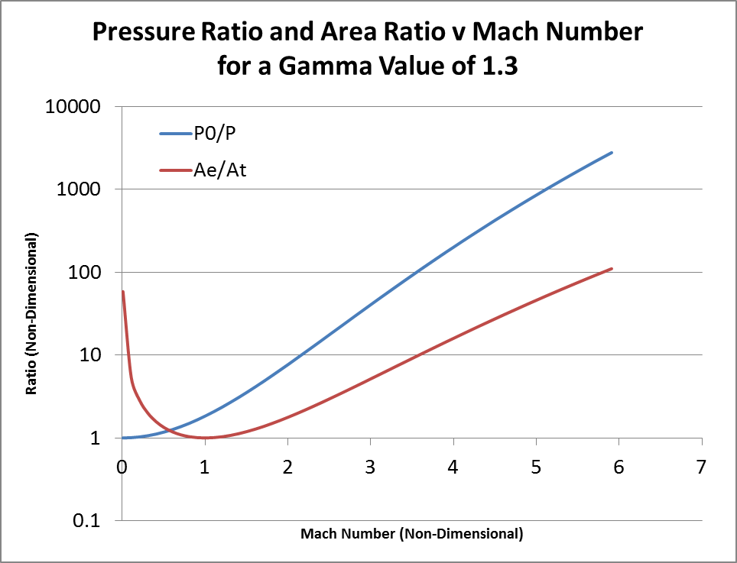
Problem Dataset
Rocket Problem
Chamber Stations
CEAM allows nozzle and chamber stations to be defined two ways, Pressure ratio and area ratio
Pressure Ratio
Pressure ratios can used to define the nozzle
Only a single solution exists for a defined pressure ratio. A supersonic or subsonic declaration is unnecessary
Pressure ratios are dimensionless must be greater than 1
The keyword is ’pi/p’
The Pi pressure is the total pressure for an infinite chamber, and the chamber pressure for a finite chamber
For example ’pi/p’,4,1.01,150,y

Slide 34
Problem Dataset
Rocket Problem - Continued
Chamber and Nozzle Definition
Area Ratio
Both a supersonic and subsonic solution exists for a given area ratio. Therefore, a keyword is used to define which solution the user wants
Subsonic solutions use the keyword ’sub’
Supersonic solutions use the keyword ’sup’
Area ratios are dimensionless and be entered as numbers, arrays, and/or variables
Area ratios must be greater than 1
Subsonic area ratios must be less than the contraction ratio, if defined
The area ratio values must follow the respective flow type
The area ratios do not have to be entered in any particular order
For example ’sub’,5,2,4,x,3:-0.1:1.5,’sup’,2,4,100,x,5
In the output, subsonic area ratios are identified as a negative value
An output title column of AR=5 refers to the supersonic solution whereas AR=-5 refers to the subsonic solution

Slide 35
Problem Dataset
Rocket Problem - Continued
Equilibrium and Frozen Flow
Equilibrium
Equilibrium is the default chemical flow type
The composition is allowed to change to satisfy the minimization of the Gibbs free energy at each station
The keyword for equilibrium flow is ’eq’, but it is unnecessary
Frozen Flow
Frozen flow is useful when chemical reaction time exceed nozzle residence time. That is, frozen flow is useful when the products will be ejected from the nozzle before the chemical reaction to reduce the Gibbs free energy can take place.
The infinite chamber is always calculated as a equilibrium flow
The user can control at what station the flow is frozen as an optional input
CEAM will calculate equilibrium conditions to the point, and frozen conditions thereafter
The keywords for frozen flow are ’fr’ and ’fz’
The keywords for the frozen station is ’nfr’ and ’nfz’
To freeze the flow at the throat, value is set equal to 2
The value of nfz corresponds the supersonic column at which the flow should be declared to be frozen – refer to NASA RP-1311 Part II

Slide 36
Problem Dataset - Continued
Examples
'problem','hp','o/f',6.0338,'case','Block_II_testing','p,psia',3126.24,
'prob','case','Example-3','hp','p(bar)',100,10,0.1,'o/f',17,
'problem','tp','eql','o/f',6.0:.2:7.0,'case','aerojet-gh2-go2(1000)', 'p,psi',1000.,2000,'t,R',5500:500:6500,
problem','case','Example-1','tp','p(atm)',1,0.1,0.01,'t(k)',3000,2000, 'r.eq.ratio',1,1.5,
'problem','sp','case','NameSP','o/f',6.00,'p,psi',628.960,'s/r',2.17959,
'problem','rocket','equilibrium','fac','acat',3,'o/f',2.34,2.5,'case','fastrak(O2/RP-1)','p(psi)',633,800,'subsonic(ae/at)',2.59,1.01, 'supsonic(ae/at)',1.01,15.0,30.0,
'problem','rocket','frozen','p,psia',300,'sup,ae/at',10.0000,
'problem','rocket','equilibrium','o/f',5.55157,'case','Example-8', 'p,bar',53.3172,'subar',1.58,'pi/p',10,100,1000,'supar',25,50,75,
'problem','rocket','equilibrium','o/f',5.55157,'case','Example-10','p,bar',53.3172,'fac','ma,kg/m^2',1333.9,'pi/p',10,100,1000,'supar',25:25:75,
'problem','rocket','equilibrium','case','Example-12','p,psi',1000,'pi/p', 68.0457,'o/f',2.5,'eql','fr','nfz',2,'sup',5,10,25,50,75,100,150,200,
'prob','hp','p,psia',1000,
'problem','rocket','fz','p,psia',300,'sup,ae/at',10.0000,
'problem','case','Example-2','phi,eq.ratio',1,'tv','t(k)',3000, 'rho,g/cc',9.186e-5,8.0877e-6,6.6054e-7

Slide 37
Output Dataset
The output dataset contains keywords to identify the format of CEAMs output.
The output dataset is optional
The output dataset keyword is ‘outp'
CEAM will always display/produce bulk thermodynamic properties and molar product composition fractions
Product Composition
The product composition is a standard output of CEAM. The composition can be defined one of two ways
Molar Fractions
Molar fractions are the default definition of the product composition
There is not a keyword for molar values
Mass Fractions
Mass fractions can be calculated as an output as an alternative to molar fractions
The keyword for mass fractions is exactly ‘massf'

Slide 38
Output Dataset
Units systems
The default units of CEAM output are identical to the default units of the FORTRAN version. (SI mks with a few exceptions)
Unit systems available in the FORTRAN version (default and calories) have been expanded in CEAM cgs, mks, and English
The keywords are not case sensitive. The unit systems are as follows:
 | English | MKS | CGS | Default | Calories
keyword | eng | mks | cgs | N/A | cal
Pressure | psia | bar | mmh | Bar | Atm
Temperature | R | K | K | K | K
Density | lbm/ft^3 | kg/m^3 | g/cc | kg/m^3 | g/cc
Enthalpy | BTU/lbm | kJ/kg | J/g | kJ/kg | Cal/g
Energy | BTU/lbm | kJ/kg | J/g | kJ/kg | Cal/g
Gibbs | BTU/lbm | kJ/kg | J/g | kJ/kg | Cal/g
Entropy | BTU/lbm-R | kJ/kg-K | J/g-K | kJ/kg-K | Cal/g-K
Cp | BTU/lbm-R | kJ/kg-K | J/g-K | kJ/kg-K | Cal/g-K
Velocity | Ft/s | m/s | cm/s | m/s | m/s
Viscosity | lbm/ft-s | uPa-s | uPa-s | Millipoise | Millipoise
Thermal Conductivity | BTU/hr-ft-R | W/m-K | W/cm-K | mW/cm-K | Mcal/cm-K-s

Slide 39
Output Dataset
Short
Short eliminates the intermediate calculations from printing to the screen or file. Short will speed up the program, but can make debugging more difficult. The keyword is not case sensitive and is ‘short‘.
Trace
Trace can be used to tighten the convergence value requirement to enhance accuracy for trace product species. The keyword is not case sensitive and is ‘trac‘. The value of trace may be a number or a variable.
Transport Properties
Transport properties can be calculated by using the transport module in CEAM. The module default is OFF, but it will execute if the keyword ‘tran‘ is in the output dataset.

Slide 40
Output Dataset - Continued
Examples
'output','tran',
'output','trace',1e-15,'mks',
'outp','transport','trac',1e-9,'mks',
'output','calories',
'output','short',
'output','transport','mks',
'output','massf','transport‘,’eng’
'output','mks',
'outp','massf','transport','mks‘
'output','transport','calories‘

Slide 41
End Dataset
The end dataset ends the command for CEA with the one exception of the print option.
The end dataset is mandatory
The end dataset keyword is ‘end‘
The print option is entered after the end dataset
If a print option is not entered, then CEAM will run in the background and write the data to the data structure. This is useful in a test data reduction routine.
If the print option uses the keyword ‘screen’ then CEAM will print the output to the screen and the data structure.
If the print option uses any other word, then an output file of that name is generated in the user’s file path. This is similar to what of the CEA FORTRAN did.

Slide 42
Accessing Outputs
Three methods for output of CEAM
1) Screen print
Add ‘screen’ as the last very last input (after ‘end’)
2) File print
Add any name other than ‘screen’ as the last very last input (after ‘end’), and MATLAB will save the output file to that name in the MATLAB folder
The output will be identical to the screen print
3) Structure Array
CEAM will always generate a structure array in the output variable declared in the command line

Slide 43
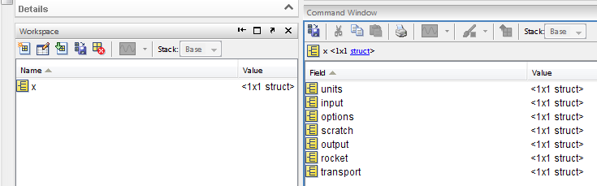
Accessing the Structure Outputs
The output structure includes between five and seven fields
The structure can be opened either by typing the name into the command line, or by double clicking on it in the workspace
The fields of greatest interest will likely be “output”, and if applicable, “transport” and/or “rocket”
Double clicking on a field name will open the structure of that field

Slide 44

Accessing the Structure Outputs-Continued
Below is an example of gamma from a Rocket problem
Gamma can be found either by double clicking on the appropriate field or by entering “x.output.gamma” into the command line

Slide 45
Accessing the Structure Outputs-Continued
The final array is #MRx#PCx#T array except for rocket which is a #MRx#PCx#Area Ratio array
Consider a hydrogen-oxygen engine with MRs from 4.8-6.0 in increments of 0.1 and Pcs from 2800-3500 in increments of 100 psia
The table of gammas is shown highlighted below. The header rows have been added for clarity

Slide 46
Accessing Output- Continued
Examples
P=CEA('problem','rkt','equilibrium','o/f',MR,'p,psi',mcc_pc,...
'fac','acat',MCC_CR,'subar',MCC_CR-.01,... 'reactants','fuel','H2(L)','H',2,'wt%',...
100,'t,r',fu_t,'h,btu/lbm',fu_h,'oxid','O2(L)','O',2,'wt%',100,'t,r',ox_t,...
'h,btu/lbm',ox_h,'output','short','eng','end');
g=P.output.eql.gamma(4); % gamma
t=P.output.eql.temperature(4); % temperature
mw=P.output.eql.mw(4); % molecular weight-combustion products
P=CEA('problem','tp','equilibrium','o/f',GG_MR,'p,psi',FTIp,...
't,R',FTIt,'reactants','fuel','H2(L)','H',2,'wt%',100.,'h,btu/lbm',...
GG_Hf,'oxid','O2(L)','O',2,'wt%',100.,'h,btu/lbm',GG_Ho,'output',...
'short','eng','end');
SummarySheet(i,FTI_Cp_cn)=P.output.cp;
SummarySheet(i,FTI_enthalpy_cn)=P.output.enthalpy;
SummarySheet(i,FTI_entropy_cn)=P.output.entropy;
SummarySheet(i,FTI_gamma_cn)=P.output.gamma;
SummarySheet(i,FTI_mw_cn)=P.output.wm;
SummarySheet(i,FTI_r_cn)=P.output.cp-P.output.cp/P.output.gamma;
sr_FTI(i)=P.output.entropy;

Slide 47
Generic Problem construction

Slide 48
HP Problems
Enthalpy-Pressure (HP) problems are for equilibrium calculations only
Out=CEA(‘prob’,’HP’,’o/f’,6.2,’p,psia’,2000,’reac’,’fu’,’H2(G)’,’H’,2,’h,btu/lbm’,-112.9,’t(r)’,200,…
‘ox’,’O2(L)’,’O’,2,’h,btu/lbm’,-50.4,’t(r)’,170,’end’);
HP problems require, at a minimum, that:
1) HP be declared
2) At least one chamber pressure defined in the problem dataset
3) At least one mixture ratio type and value defined in the problem dataset or moles defined in the reactant dataset
4) Enthalpy defined either as a bulk property in the problem dataset, or enthalpy defined for every reactant
5) A temperature defined for every reactant
1
3
2
4
5
4
5

Slide 49
TP Problems
Temperature-Pressure (TP) problems are for equilibrium calculations only
Out=CEA(‘prob’,’TP’,’o/f’,6.2,’p,psia’,2000,’T(R),6200, …
’reac’,’fu’,’H2’,’H’,2,‘ox’,’O2(L)’,’O’,2,’end’);
TP problems require, at a minimum, that:
1) TP be declared
2) At least one chamber pressure defined in the problem dataset
3) At least one mixture ratio type and value defined in the problem dataset or moles defined in the reactant dataset
4) At least one combustion temperature defined
1
3
2
4

Slide 50
SP Problems
Entropy-Pressure (SP) problems are for equilibrium calculations only
Out=CEA(‘prob’,’SP’,’o/f’,6.2,’p,psia’,2000,’S(btu/lbm-R),2.851,…
’reac’,’fu’,’H2’,’H’,2,‘ox’,’O2(L)’,’O’,2,’end’);
SP problems require, at a minimum, that:
1) SP be declared
2) At least one chamber pressure defined in the problem dataset
3) At least one mixture ratio type and value defined in the problem dataset or moles defined in the reactant dataset
4) At least one combustion entropy defined
1
3
2
4

Slide 51
TV Problems
Temperature-Volume (TV) problems are for equilibrium calculations only
Out=CEA(‘prob’,’TV’,’o/f’,6.2,’rho,lbm/ft3’,1.1,’T(R),6200,’…
reac’,’fu’,’H2’,’H’,2,‘ox’,’O2(L)’,’O’,2,’end’);
TV problems require, at a minimum, that:
1) TV be declared
2) At least one combustion specific volume or density defined
3) At least one mixture ratio type and value defined in the problem dataset or moles defined in the reactant dataset
4) At least one chamber temperature defined in the problem dataset
1
3
2
4

Slide 52
UV Problems
Energy-Volume (TV) problems are for equilibrium calculations only
Out=CEA(‘prob’,’UV’,’o/f’,6.2,’rho,lbm/ft3’,1.1,’u(btu/lbm), …
-2000,’reac’,’fu’,’H2’,’H’,2,‘ox’,’O2(L)’,’O’,2,’end’);
UV problems require, at a minimum, that:
1) UV be declared
2) At least one combustion specific volume or density defined
3) At least one mixture ratio type and value defined in the problem dataset or moles defined in the reactant dataset
4) At least one chamber energy defined in the problem dataset
1
3
2
4

Slide 53
Rocket Problems
Rocket (rocket, rkt) problems are for both equilibrium and frozen calculations
Rocket problems are HP problems with more inputs
Out=CEA(‘prob’,’rocket’,’equilibrium’,’o/f’,6.2,’p,psia’,2000, …
’reac’,’fu’,’H2’,’H’,2,’h,btu/lbm’,-112.9,’t(r)’,200,‘ox’,’O2’,’O’,2,’h,btu/lbm’,50.4,’t(r)’,170,’end’);
Rocket problems require, at a minimum all HP property inputs and, that:
1) Rocket be declared
2) Equilibrium and/or frozen be declared
1
2

